Slide 1


School of Computer Science & IT Department of BCA
INTRODUCTION TO LINUX(20BCA1C06)
MODULE 3: Vi Editor
Faculty : Dr. Ananta Ojha

Slide 2
Session-1
Introduction Vi Editor
Different Modes
Basic Editing Commands
Save and Quit vi

Slide 3
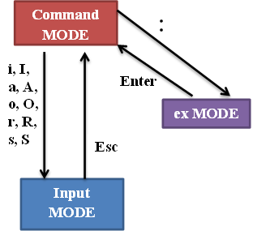
Vi Editor: Introduction
vi (pronounced "vee-eye") is short for "vi"sual editor.
vi is a text editor with all basic editing features. vi lets you add, change, and delete text, but does not provide such formatting capabilities as centering lines or indenting paragraphs etc. like a word processor.
You can open and close a file, moving around in a file and perform elementary editing on the text.
It is a full-screen editor, and displays a window of the file being edited that shows 24 lines of 80 characters each text in a standard terminal.
Syntax: $ vi filename
where filename is the name of the file to open (an existing or a new one). If the file is not in your current directory, you must use the full pathname.
vi Modes:
Command Mode
Input Mode / Edit Mode/ Insert Mode
ex Mode / Last Line Mode
When you start the vi editor you will be in Command Mode. You issue commands for editing and moving around the file.
Input Mode allows you to enter text into the file, while ex Mode allows you to exit the editing session and close vi editor.

Slide 4
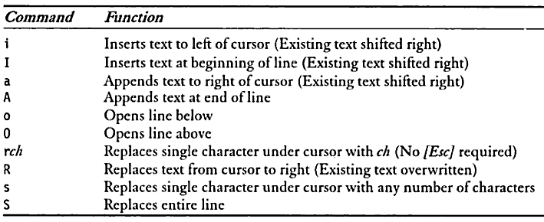
Basic Editing
Editing require that you be in command mode. Many of the editing commands have a different function depending on whether they are typed as upper- or lowercase.
Moving the Cursor
To move the cursor to another position, you must be in command mode. The cursor is controlled with four keys: h, j, k, l.
h left one space
j down one line
k up one line
l right one space
Inserting Text
To insert text in a line:
1. Position the cursor where the new text should go.
2. Type i
3. Enter the new text.
The text is inserted BEFORE the cursor.
4. Press <Esc> to get back to command mode.

Slide 5
Basic Editing
Replacing Words
To replace / change one word with another,
1. Move to the start of the incorrect word
2. Type cw
The last letter of the word to be replaced will turn into a $. You are now in insert mode and may type the replacement. The new text does not need to be the same length as the original.
3. Press <Esc> to get back to command mode.
To replace /change three words, type 3cw
To change the entire line, type cc
Replacing Lines
To change text from the cursor position to the end of the line:
Type C (uppercase).
Type the replacement text.
Press <Esc>.

Slide 6
Basic Editing
Deleting Characters
To delete a character from a file, move the cursor until it is on the incorrect character, then type x
The character under the cursor disappears.
To remove four characters starting from the cursor position type 4x.
To delete the character before the cursor, type X (uppercase)
Deleting Words
To delete a word, move the cursor to the first letter of the word, and type dw
This command deletes the word and the space following it. To delete three words type 3dw
Deleting Lines
To delete a whole line, type dd
The cursor does not have to be at the beginning of the line. Typing dd deletes the entire line containing the cursor and places the cursor at the start of the next line.
To delete two lines, type 2dd
To delete from the cursor position to the end of the line, type D (uppercase)

Slide 7
Basic Editing
Text Movement (you can delete text from one place and put it at another place, i.e. cut and paste)
To move a line from one place to another:
Put the cursor on the line to be deleted.
Type dd
Move the cursor to the position where you want to put the line
Type p or P
Small p will put the line below the cursor position while capital P will put the above the cursor position. You can repeat the put command by moving cursor to different places and paste the text.
To move several lines associate a number with dd, example: 3dd for 3 lines.
To move one or more words, delete the words using dw, then put the deleted words to the right of the cursor position using p or use P to put the words to the left of the cursor position.

Slide 8
Basic Editing
Yanking (you can copy text from one place and put it at another place, i.e. copy and paste)
To copy a line from one place to another:
Put the cursor on the line to be copied.
Type yy
Move the cursor to the new position
Type p or P
Small p will put the line below the cursor position while capital P will put the above the cursor position. You can repeat the put command by moving cursor to different places and paste the text.
To copy several lines associate a number with yy, example: 2yy for 2 lines
To copy one or more words, copy the words using yw, then put the copied words to the right of the cursor position using p or use P to put the words to the left of the cursor position.

Slide 9
Basic Editing
Searching String
To move quickly by searching for text, while in command mode:
Type / (slash).
Enter the text to search for.
Press <Return>.
The cursor moves to the first occurrence of that text.
To repeat the search in a forward direction, type n
To repeat the search in a backward direction, type N

Slide 10
Basic Editing
Joining Lines
To join two lines together:
Put the cursor on the first line to be joined.
Type J
To join three lines together:
Put the cursor on the first line to be joined.
Type 3J
Undoing
To undo your most recent editing, type u
To undo all the edits on a single line, type U (uppercase)
Undoing all edits on a single line only works as long as the cursor stays on that line. Once you move the cursor off a line, you cannot use U to restore the line.
Repeating
To repeat the most recent editing, type . (dot).

Slide 11
Save and Quit vi
With vi, you edit a copy of the file in the Buffer, rather than the original file. Changes are made to the original only when you save your edits.
To save the file and quit vi, type ZZ . It doesn’t have any other command to do that.
However, the vi editor is built on an earlier Unix text editor called ex. ex commands can be used within vi. ex commands begin with a : (colon) and end with a <Return>. The command is displayed on the status line as you type. Some ex commands are useful when saving and closing files.
To save the editing you have made, but leave vi running and your file open:
Press <Esc> to come to the Command Mode.
Type :w
Press <Return>.
To save the editing you have made, and quit vi use :wq or :x
To quit vi, and discard any changes your have made since last saving:
Press <Esc>.
Type :q!
Press <Return>.
If no changes have been made then use :q

Slide 12

THANK YOU Any questions…?

